Slide 1
Developing a predictive machine learning model (classifier) and deploying it as API
Cristian Zuluaga - 301095206 Wahida Hossain - 301047672 Vaishnavi Sathyan - 301101588 Ashik Lochna - 301102026

Slide 2
DATA SET
International Clothing founding in 2004, is a company that has several kinds of clothes for different seasons and occasions, as well as last trending styles designs to offer our clients the best quality when it comes to clothes. There are several features that a product could have such as style, price, rating, size, season, neckline, sleeve length, waistline, material, fabric type, decoration, and pattern type. Therefore, in order to enhance our target marketing, the company wants to have a supervised learning model implemented to have a better knowledge of their customers' desires. Because of that, we want to know what kind of combination of different variables is recommended to produce products.
The dataset called “Attribute Dataset.xlsx” is a dataset built with clothing data. The details of the variables will be described in the project development process. For this course purposes, the dataset was published in the following URL:
https://comp309-project-group6.s3.amazonaws.com/Attribute+DataSet.xlsx

Slide 3
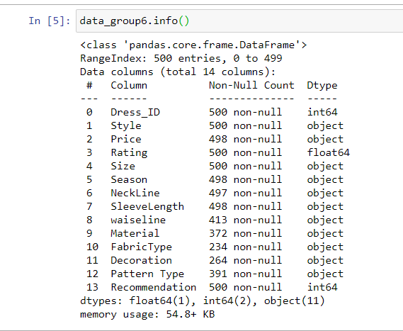
DATA LOADING
Code :
import pandas as pd
import numpy as np
import matplotlib.pyplot as plt
from pylab import rcParams
import seaborn as sb
import scipy
from scipy.stats.stats import pearsonr
-Because 12 out of 14 variables are objects (string), our Statistical assessments will not be explanatory until we normalize our data set. In order to correct analysis all variables must be numerical variables

Slide 4
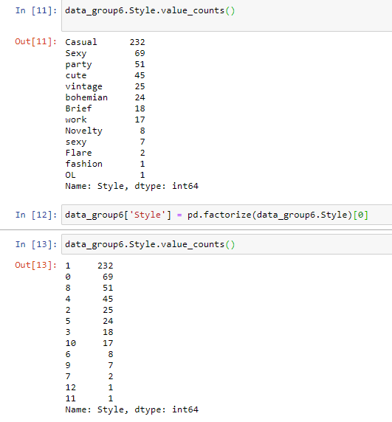
DATA MODELLING
Data Transformation Code- Styles:
data_group6.Style.value_counts()
data_group6['Style'] = pd.factorize(data_group6.Style)[0]
data_group6.Style.value_counts()
-The dataset variables must be numerical in order to have better understanding. In order to do that, the object variables (string) must to be factorized into new numeric categories.
-Missing data will be evaluated systematically it appear during the transformation process and will be explained the process used to handle it
-Like this example all the columns were transformed.

Slide 5
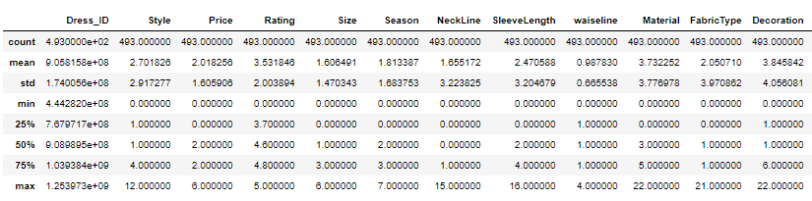
STATISTICAL ASSESMENTS
Code:
data_group6.describe()
-In order to find more explanatory information about the dataset after the data transformation. The describe method was used to show the data description
-A pearson correlation matrix was created to identify the correlation between the variables. Once either positive or negative correlation is identified among variables, more explanatory information could be extracted.
-According to the correlation graph, there are not many strong correlations among the variables; however, the more correlated variables were extracted because there was a relationship among them, even though was not very significant at first glance.

Slide 6
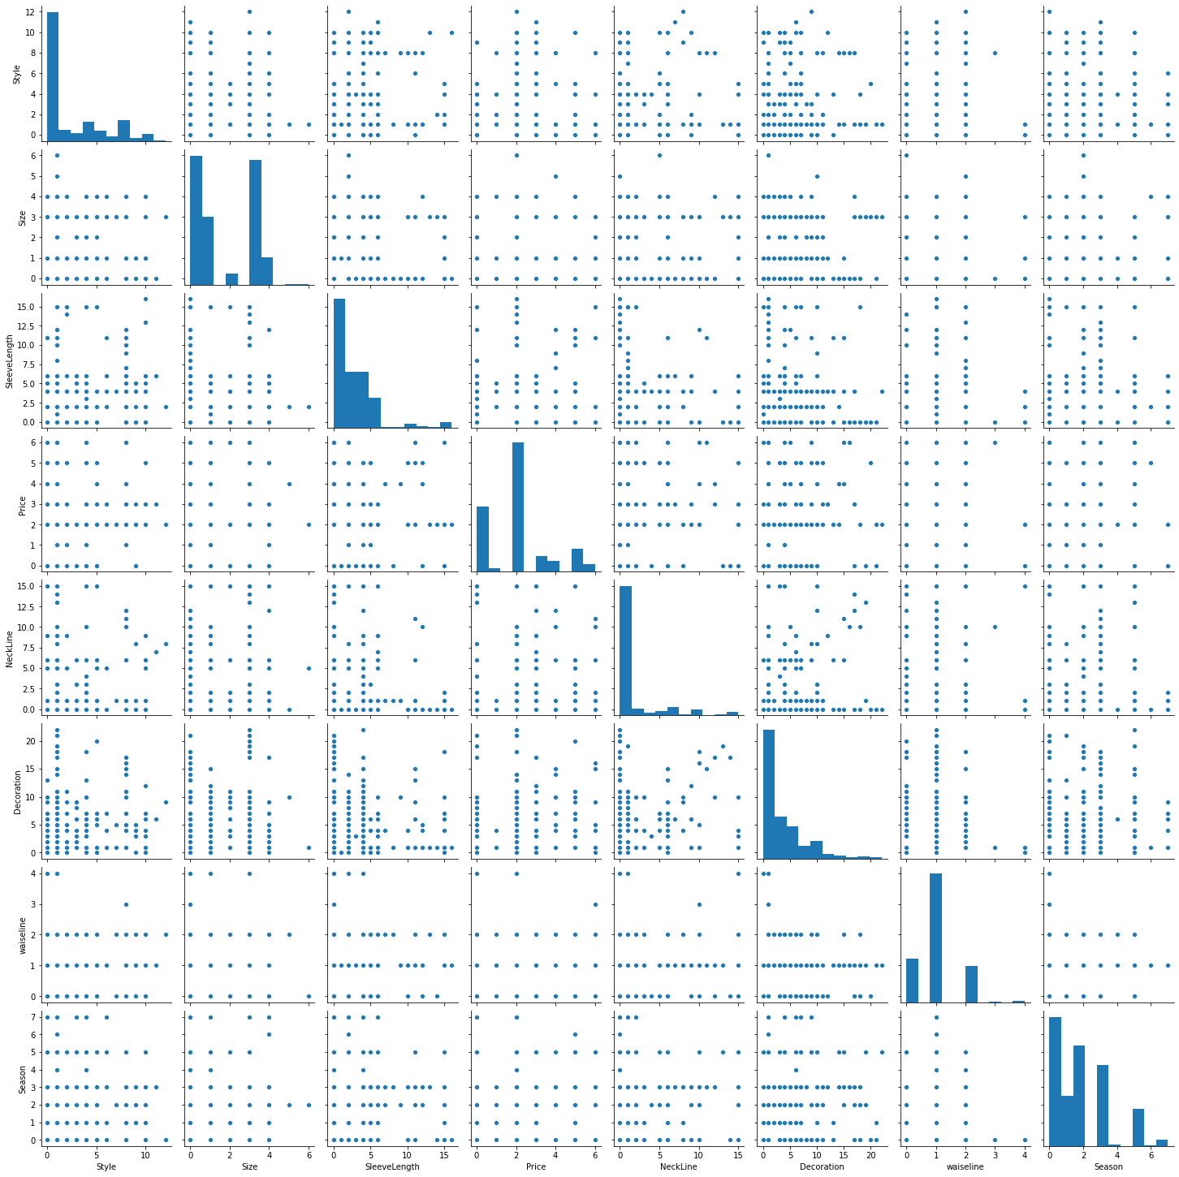
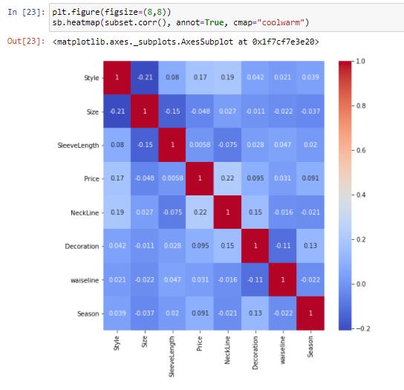
CORRELATED VARIABLES
-A subset was created to generate a new view of correlated variables
-Using heatmap methods, the graph shows that there is no strong correlation among the variables. The strongest correlation exists between Size and Style variables with -0.21

Slide 7
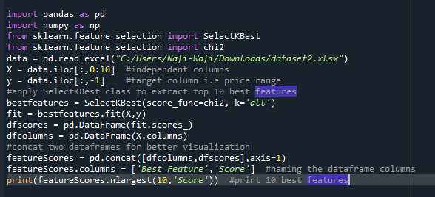

FEATURE SELECTION
-Feature selection is one of the first and important steps while performing any machine learning task. A feature in case of a dataset simply means a column. Feature selection can be done in multiple ways but there are broadly 3 categories of it: 1. Filter Method 2. Wrapper Method 3. Embedded Method
-Three benefits of performing feature selection before modeling data are:
Reduces Overfitting: Less redundant data means less opportunity to make decisions based on noise.
Improves Accuracy: Less misleading data means modeling accuracy improves.
Reduces Training Time: Less data means that algorithms train faster.
Code:

Slide 8
TRAINING,VALIDATION AND TEST SETS
-Splitting dataset is essential for an unbiased evaluation of prediction performance. In most cases, it’s enough to split your dataset randomly into three subsets:
-The training set is applied to train, or fit, your model. For example, you use the training set to find the optimal weights, or coefficients, for linear regression, logistic regression, or neural networks.
-The validation set is used for unbiased model evaluation during hyperparameter tuning. For example, when you want to find the optimal number of neurons in a neural network or the best kernel for a support vector machine, you experiment with different values. For each considered setting of hyperparameters, you fit the model with the training set and assess its performance with the validation set.
-The test set is needed for an unbiased evaluation of the final model. You shouldn’t use it for fitting or validation.

Slide 9
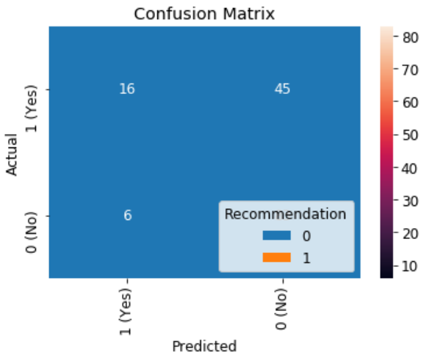
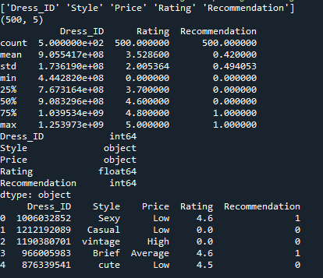
PREDICTIVE MODEL BUILDING
Logistic regression
Is one of the most used machine learning techniques. Its main advantages are clarity of results and its ability to explain the relationship between dependent and independent features in a simple manner. It requires comparably less processing power, and is, in general, faster than Random Forest or Gradient Boosting.
Code:

Slide 10
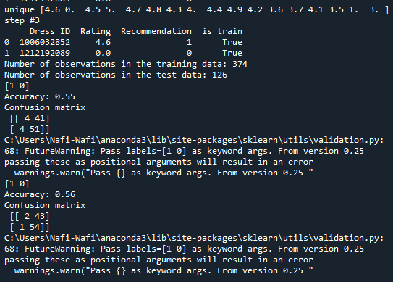
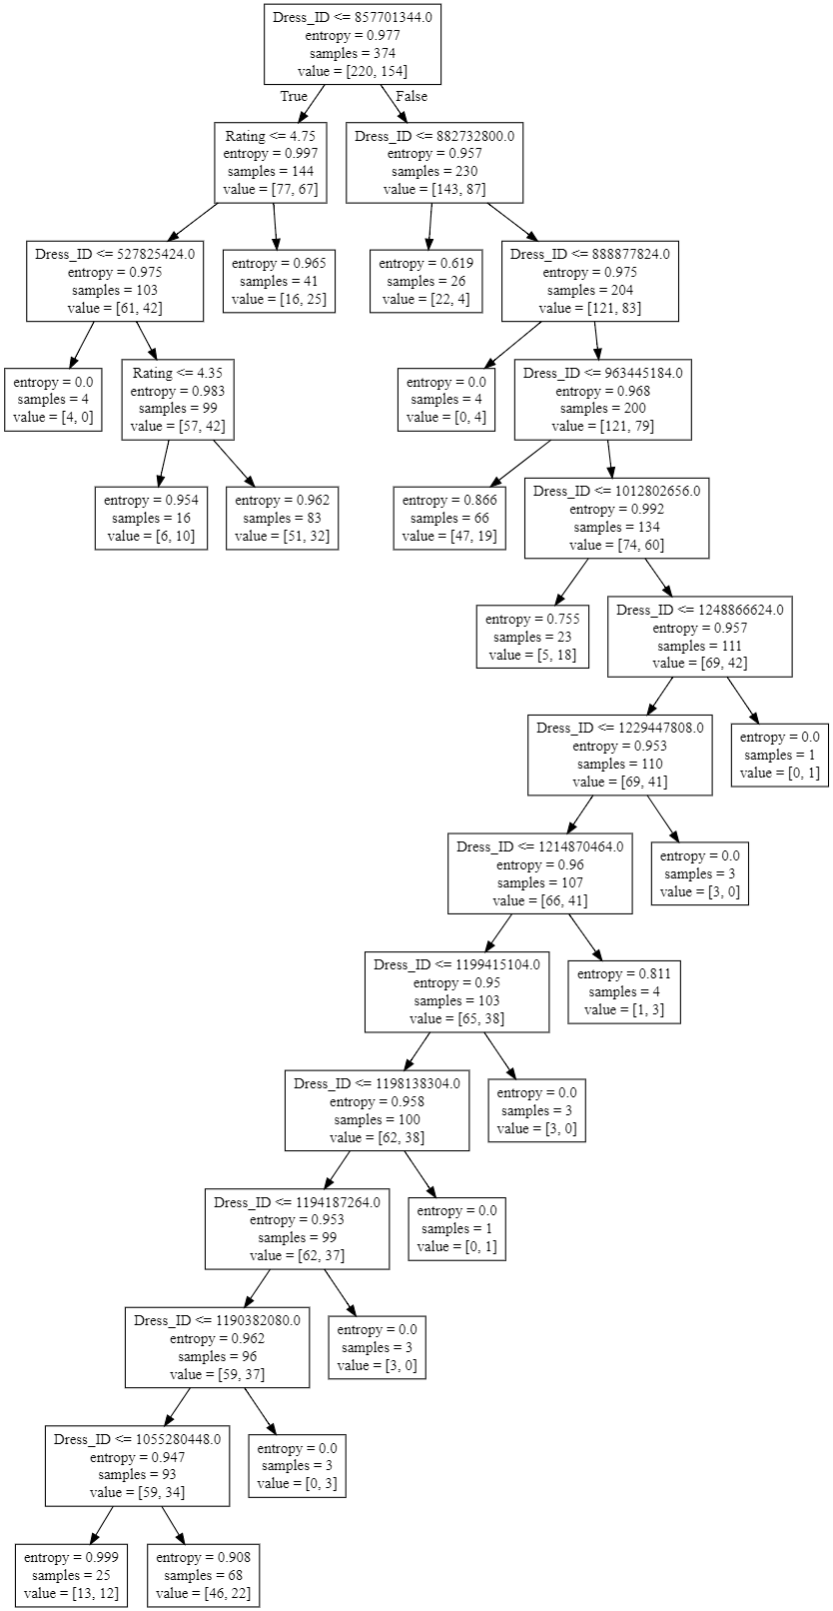
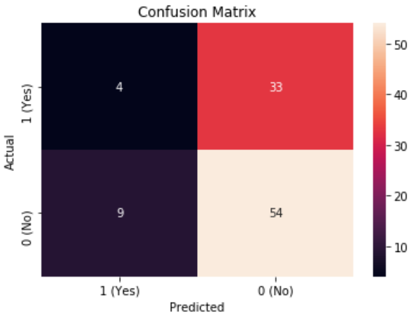
DECISION TREE
Decision Trees (DTs)
are a non-parametric supervised learning method used for classification and regression. The goal is to create a model that predicts the value of a target variable by learning simple decision rules inferred from the data features.

Slide 11
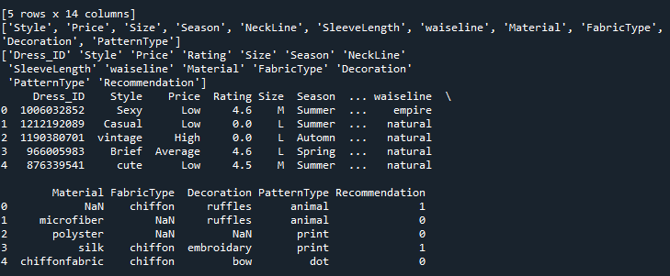
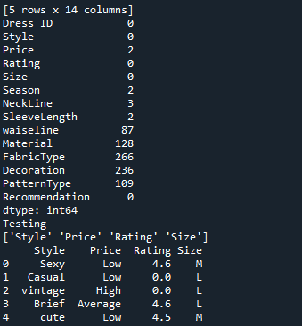
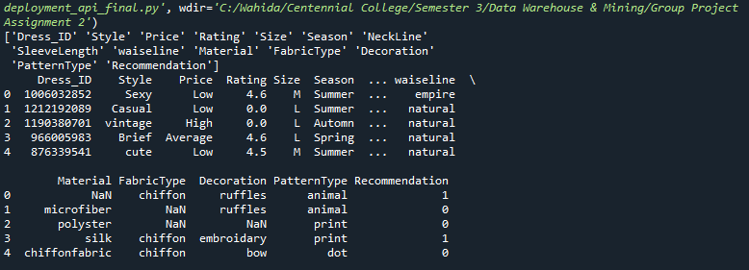
DEPLOYING THE MODEL
-There are different approaches to putting models into productions. There is generally different ways to both train and server models into production:
Train: one off, batch and real-time/online training
Serve: Batch, Realtime (Database Trigger, Pub/Sub, web-service, inApp)
Model Format
-Pickle converts a python object to to a bitstream and allows it to be stored to disk and reloaded at a later time. It is providing a good format to store machine learning models provided that their intended applications are also built-in python.

Slide 12
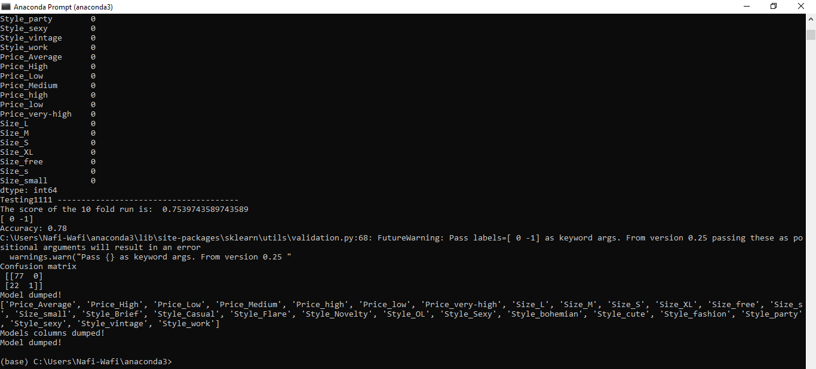
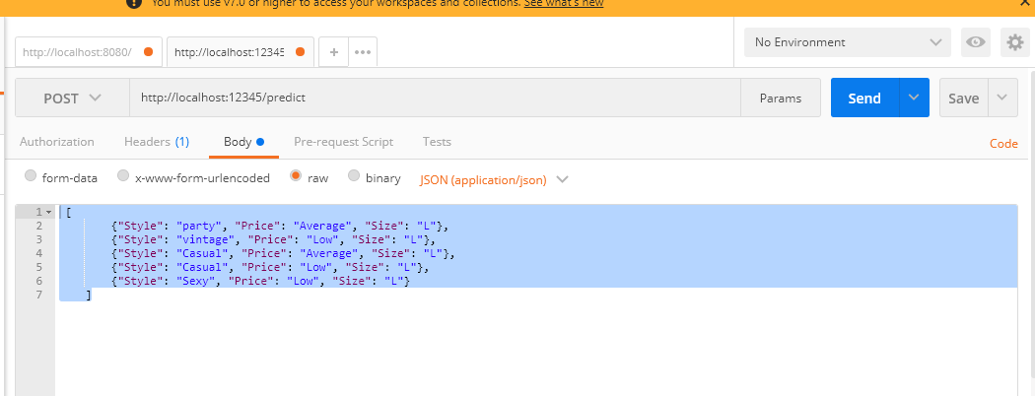
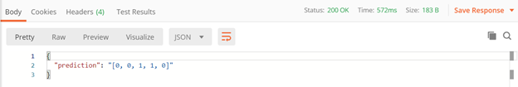
DEPLOYMENT CONTINUED
Generated .pkl file: TEST the module using JASON input through POSTMAN

Slide 13


